Slide 1
Reliability and Resiliency
Ralph Izzo, Chairman, President and CEO, PSEG

Slide 2
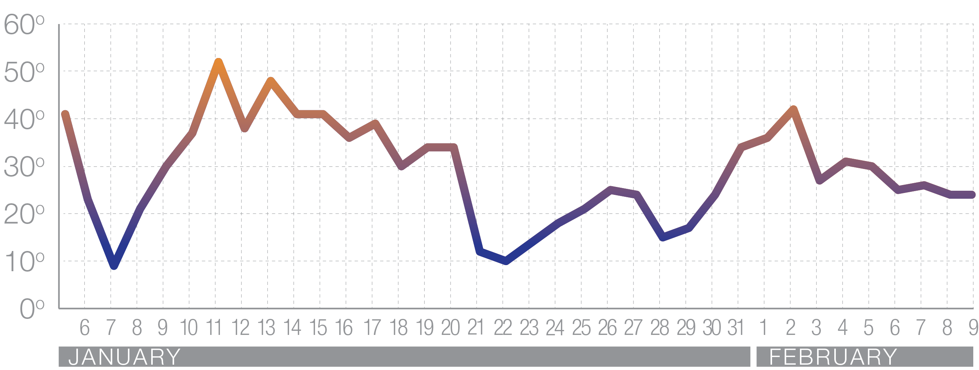
2014 Polar Vortex
Temperature (Daily average, EWR)
FAHRENHEIT

Slide 3
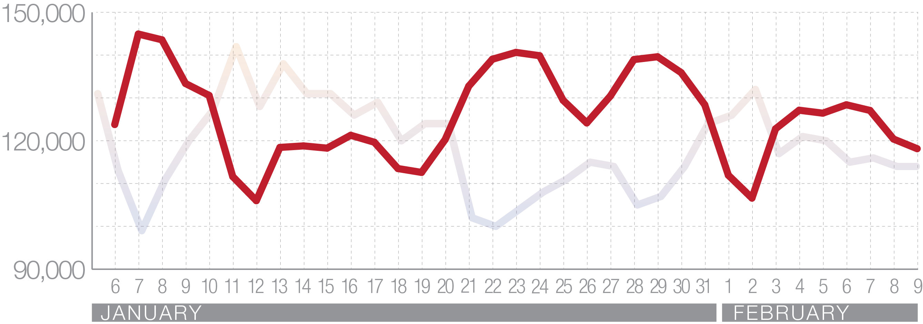
Electricity Demand
PS Zone Load
MWh

Slide 4
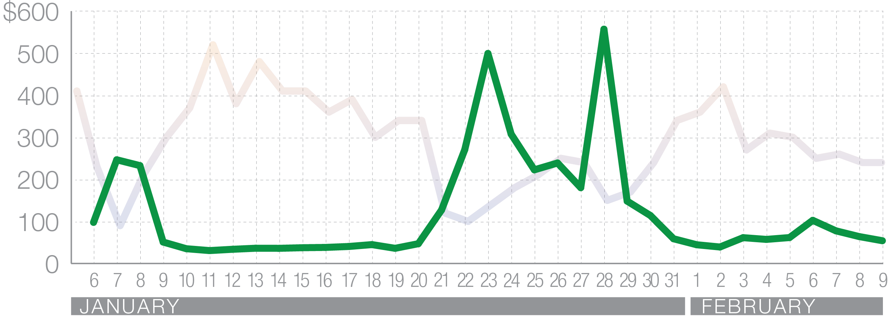
Electricity Prices
Western Hub Day Ahead RTC LMP

Slide 5
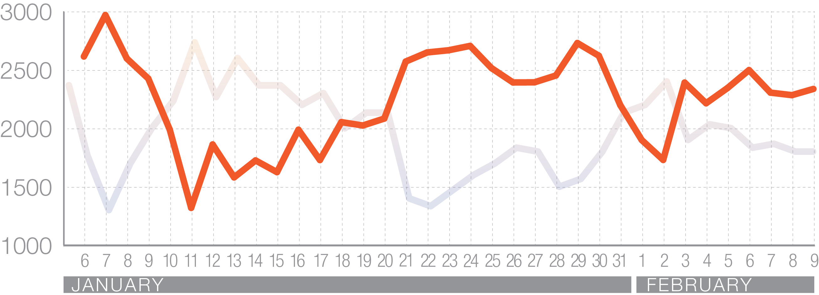
Gas Demand
Total Sendout
MDth

Slide 6
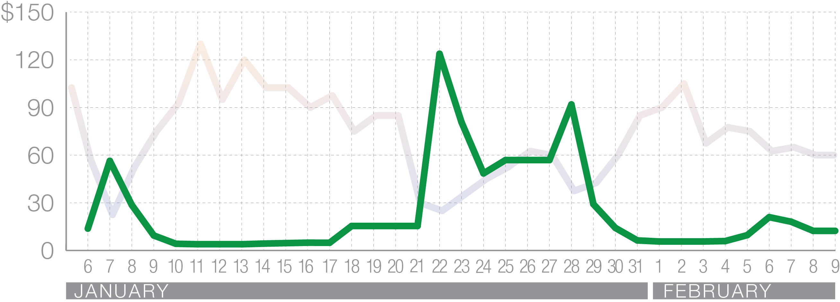
Gas Prices
Transco Z6

Slide 7
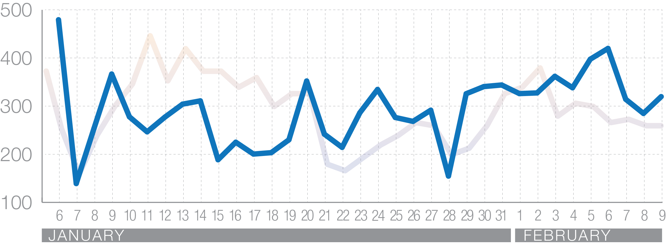
Curtailment
Electric Generation Gas Usage
MDth

Slide 8
Post-Superstorm Sandy
Actions taken:
Eliminating, raising or rebuilding 19 substations that flooded during severe weather events. At the end of the five-year Energy Strong program, 26 protected substations will be in service. $395 million

Slide 9
Post-Superstorm Sandy
Actions taken:
Installing 240 miles of new, plastic gas mains in flood-prone areas. $370 million

Slide 10
Post-Superstorm Sandy
Actions taken:
Providing the capability to remotely make changes on circuits. $106 million

Slide 11
Post-Superstorm Sandy
Actions taken:
Creating redundancy and installing automated devices that allow equipment to be controlled remotely, protecting 260 critical customers. $84 million

Slide 12
Post-Superstorm Sandy
Actions taken:
Raising and hardening eight gas meter and regulating stations. $25 million

Slide 13
Reliability is no longer enough.
Resiliency matters.

